Slide 1
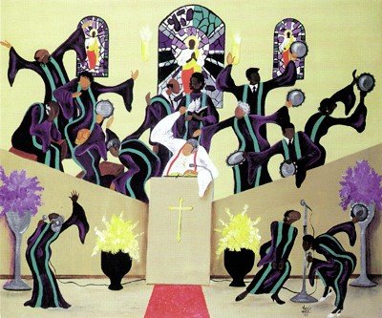
Christianity Through an Afrocentric Lens

Slide 2
T
Topics of Study
WEEK 1 The Garden of Eden
WEEK 2 African Presence in the Old Testament
WEEK 3 African Presence in the New Testament
WEEK 4 A look at the Role Early African Christians Played

Slide 3
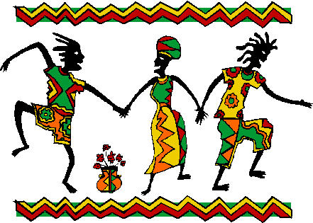
DESIRED LEARNING OUTCOMES
Rebuke the false claims that Christianity is a White’s man religion.
Eradicate the incorrect assumption stating slavery in America introduced Africans to Christianity.
Highlight the African’s Contributions to Christion Thoughts.

Slide 4
Let’s Begin at the Beginning “The Garden of Eden”
Genesis 2 New Revised Standard Version (NRSV)
¹⁰ A river flows out of Eden to water the garden, and from there it divides and becomes four branches.
¹¹ The name of the first is Pishon; it is the one that flows around the whole land of Havilah, where there is gold;
¹² and the gold of that land is good; bdellium and onyx stone are there.
¹³ The name of the second river is Gihon; it is the one that flows around the whole land of Cush.
¹⁴ The name of the third river is Tigris, which flows east of Assyria. And the fourth river is the Euphrates.
¹⁵ The Lord God took the man and put him in the garden of Eden to till it and keep it.

Slide 5
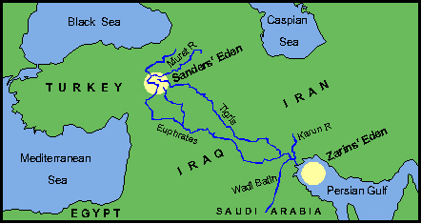
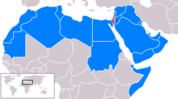
¹⁴ The name of the third river is Tigris, which flows east of Assyria. And the fourth river is the Euphrates

Slide 6
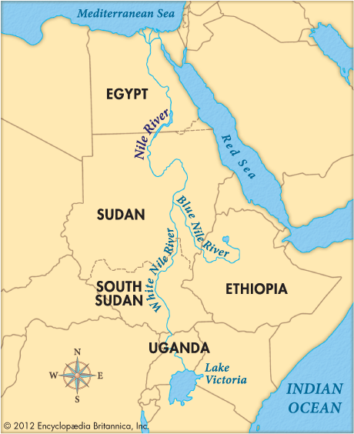
¹¹ The name of the first is Pishon; it is the one that flows around the whole land of Havilah, where there is gold;
¹² and the gold of that land is good; bdellium and onyx stone are there.
¹³ The name of the second river is Gihon; it is the one that flows around the whole land of Cush.

Slide 7
We know the Pishon and the Gihon Rivers cannot be located today by those names.
What is overlooked is the simple fact that the Nile River system includes both the White Nile and the Blue Nile which join at the present capital of Sudan.
We Know he Nile River which derives its name from the Latin word “nilus”.
The Eden tradition according to scholars of 10th century B.C, the Latin language did not exist therefore other names had to be used for what we today call the Nile.

Slide 8
Genesis 2:11-12 refers to the Pishon River and describes it in relation to the land of Havilah. In Genesis 10:7, Havilah is said to be a son of Cush (Ethiopia), thereby helping to clarify the association between the Pishon River and ancient Africa.
Furthermore, one should note the minerals (gold, bdellicum and onyx) of Havilah in Genesis 2:12; these were plentiful in biblical Africa, notably Cush and Put.

Slide 9
The second river in the Eden narrative has an integral relationship with Africa. Genesis 2:13 stats very clearly that the Gihon River “compaseth the land of Ethiopia”. Doubtless, we have here an allusion to the Blue Nile.
Most modern Western scholarship have preferred to focus on Mesopotamia as the “Fertile Crescent” where one finds the Tigris and Euphrates rather than Africa. Similarly, these same scholars have created the non-African Middle East and presided over the subtle process of de-Africanizing the entire ancient world.

