Slide 1
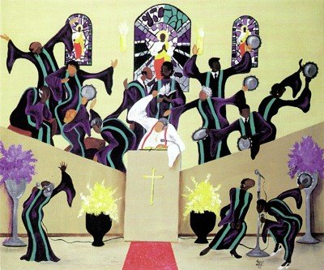
Christianity Through an Afrocentric Lens

Slide 2
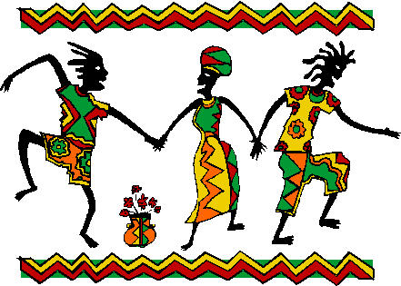
Objective and Focus
(1) Rebuke the false claims that Christianity is a White’s man religion.
(2) Eradicate the incorrect assumption stating slavery in America introduced Africans to Christianity.
(3) Highlight the African’s Contributions to Christion Thoughts.

Slide 3
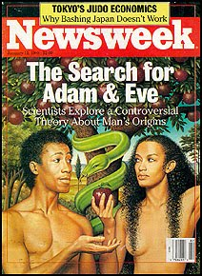
WEEK 1 TOPIC: The Garden of Eden LESSON OBJECTIVE: To show an African Presence at the beginning.

Slide 4
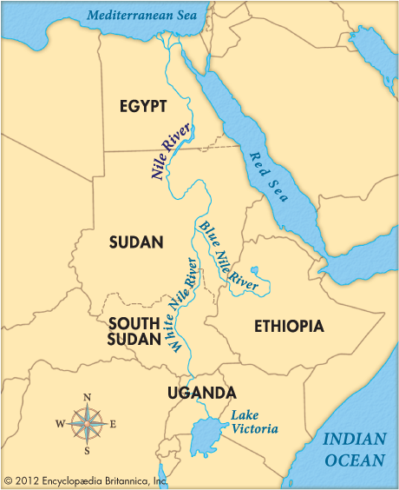
¹¹ The name of the first is Pishon; it is the one that flows around the whole land of Havilah, where there is gold;
¹² and the gold of that land is good; bdellium and onyx stone are there.
¹³ The name of the second river is Gihon; it is the one that flows around the whole land of Cush.

Slide 5
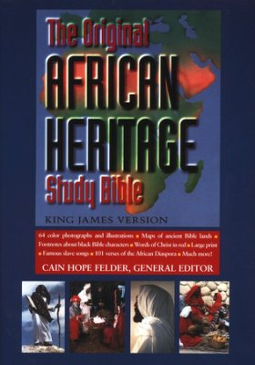
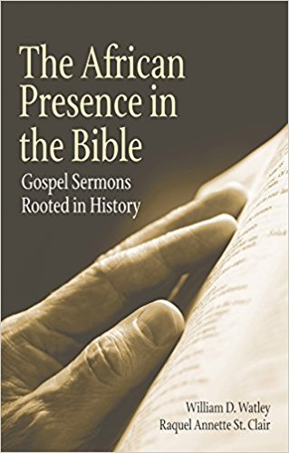
Book Source for last week’s lesson

Slide 6
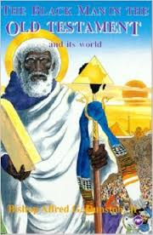
WEEK 2 TOPIC: African Presence in the Old Testament LESSON OBJECTIVE: Studying the Life of Moses

Slide 7
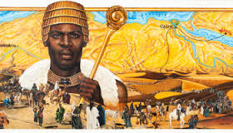
Introduction
Perhaps no person in history, outside of Jesus Christ, has made such a profound impression on the world as Moses, the great lawgiver of Israel.
The life of Moses covers four of the five books of the Pentateuch (80%) — Exodus, Leviticus, Numbers and Deuteronomy — includes Israel's deliverance from Egypt, Crossing of the Red Sea, Receiving the Law at Sinai, and the march toward Canaan. Moses life accounts for 10% of the entire Old Testament.
This great liberator was of African decent, born in Egypt. Moses was a black man.

Slide 8
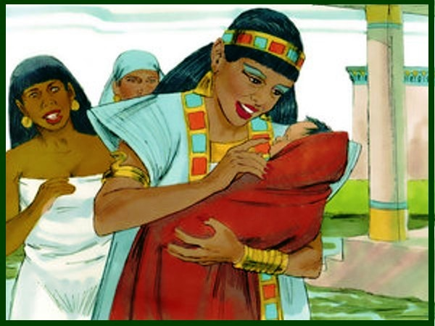
The Birth of Moses
Moses was born (c. 1370 B.C.) the son of Amram and Jochebed, who were Levites. (Ex. 2:1–2; Ex. 6:20; Num. 26:59.)
He was hidden in the house of his parents for three months, then taken to the river for safety. His discovery and adoption by the daughter of Pharaoh concluded the recorded account of his early years. (Ex. 2:3–10; Acts 7:20–21.)

Slide 9
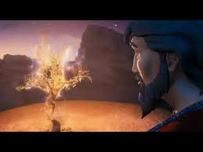
The Call of Moses
Exodus 3:1-5New Revised Standard Version (NRSV)
Moses at the Burning Bush
Moses was keeping the flock of his father-in-law Jethro, the priest of Midian; he led his flock beyond the wilderness, and came to Horeb, the mountain of God. ² There the angel of the Lord appeared to him in a flame of fire out of a bush; he looked, and the bush was blazing, yet it was not consumed. ³ Then Moses said, “I must turn aside and look at this great sight, and see why the bush is not burned up.” ⁴ When the Lord saw that he had turned aside to see, God called to him out of the bush, “Moses, Moses!” And he said, “Here I am.” ⁵ Then he said, “Come no closer! Remove the sandals from your feet, for the place on which you are standing is holy ground.”

Slide 10
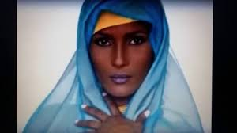
Moses’ 2nd Wife
Numbers 12:1New Revised Standard Version (NRSV)
While they were at Hazeroth, Miriam and Aaron spoke against Moses because of the Cushite woman whom he had married (for he had indeed married a Cushite woman);
Cushite in the bible means “burn face”. Moses’ second wife, was a Cushite, a pure black African woman.

Slide 11
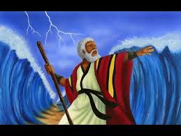
The Liberator
God instructed Moses to return to Egypt and free the Hebrews from slavery.
All the ten plagues, stretching over 10 days, affected only the Egyptians and passed over the Hebrews, leaving them safe.
The tenth plague was the most dangerous of all and caused death of the first-born male of all Egyptian families. Getting immensely upset on losing his son, the Pharaoh asked Hebrews to leave Egypt.
Pharaoh had changed his mind and ordered his army to get the Hebrews back. Though the army chased the Hebrews, a miracle happened at Red Sea and they were saved. The miracle was - following God's advice, Moses lifted up his rod on reaching the sea. As a result, the water of the sea parted, making a dry path for the Hebrews. After the Hebrews reached the shore, Moses lifted up his rod again and the path closed, drowning Pharaoh's army

Slide 12
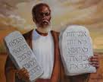
The Law Giver
The arduous journey of Hebrews, as commanded by God, ended when they reached Mount Sinai. While the people camped at the edge of the mountain, Moses went to the top, to meet God. Upon reaching the top, Moses received ten laws (Ten Commandments), which told people how to live.

Slide 13
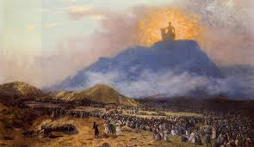
The Legacy
It is impossible to study adequately the life of Moses in a short hour bible study. Yet, we can get an overall picture of his life as we looked at certain situations and key events.
Deuteronomy 34:10New Revised Standard Version (NRSV)
Never since has there arisen a prophet in Israel like Moses, whom the Lord knew face to face.

